Slide 1

Data Science ODL
Ensemble Techniques

Slide 2
Ensemble Techniques
Presentation is based on the slides provided by
Intro. Data Mining Book authors: Tan, Steinbach, Kumar

Slide 3
Outline
Why Do Ensemble Methods Work?
Necessary Conditions for Ensemble Methods
Bias-Variance Decomposition
General Approach of Ensemble Learning
Bootstrapping
Bagging (data points)
Random Forest (data points and attributes)
Boosting
AdaBoost

Slide 4
Ensemble Methods
Construct a set of base classifiers learned from the training data
Predict class label of test records by combining the predictions made by multiple classifiers (e.g., by taking majority vote)

Slide 5
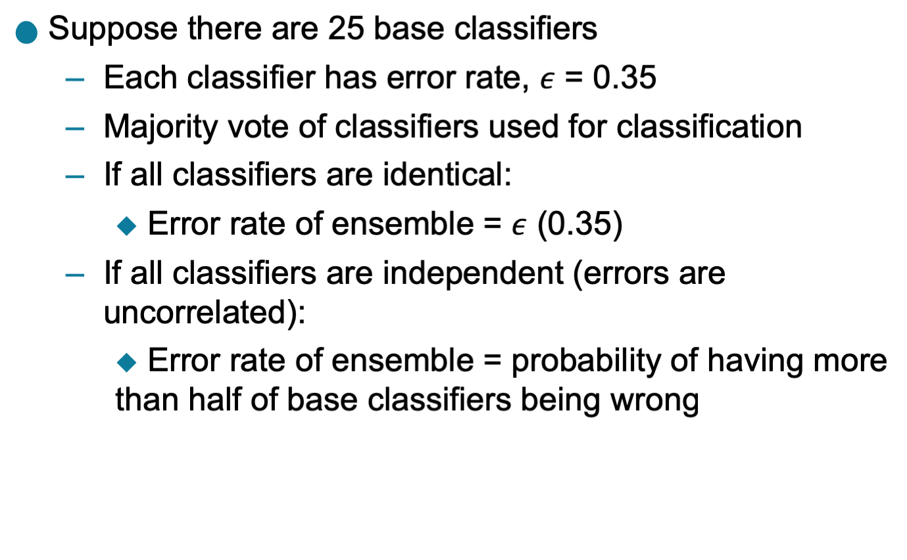
Example: Why Do Ensemble Methods Work?

Slide 6
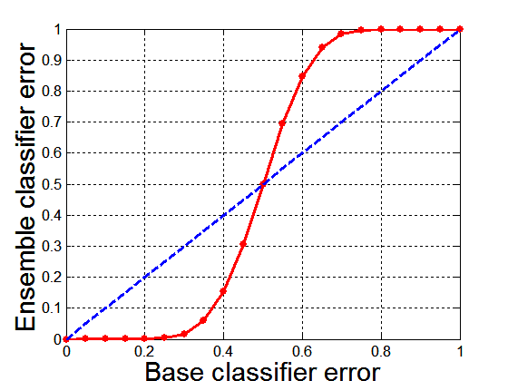
Necessary Conditions for Ensemble Methods
Ensemble Methods work better than a single base classifier if:
All base classifiers are independent of each other
All base classifiers perform better than random guessing (error rate < 0.5 for binary classification)
Classification error for an ensemble of 25 base classifiers, assuming their errors are uncorrelated.

Slide 7
Rationale for Ensemble Learning
Ensemble Methods work best with unstable base classifiers
Classifiers that are sensitive to minor perturbations in training set, due to high model complexity
Examples: Unpruned decision trees, ANNs, …

Slide 8
Bias-Variance Decomposition
Analogous problem of reaching a target y by firing projectiles from x (regression problem)
For classification, gen. error or model m can be given by:

Slide 9
Bias-Variance Trade-off and Overfitting
Overfitting
Underfitting
Ensemble methods try to reduce the variance of complex models (with low bias) by aggregating responses of multiple base classifiers

Slide 10
General Approach of Ensemble Learning
Using majority vote or weighted majority vote
(weighted according to their accuracy or relevance)

Slide 11
Constructing Ensemble Classifiers
By manipulating training set
Example: bagging, boosting, random forests
By manipulating input features
Example: random forests
By manipulating class labels
Example: error-correcting output coding
By manipulating learning algorithm
Example: injecting randomness in the initial weights of ANN

Slide 12
Bagging (Bootstrap AGGregatING)
Bootstrap sampling: sampling with replacement
Build classifier on each bootstrap sample
Probability of a training instance being selected in a bootstrap sample is:
1 – (1 - 1/n)^{n} (n: number of training instances)
~0.632 when n is large

Slide 13
Bagging Algorithm

Slide 14
Bagging Example
Consider 1-dimensional data set:
Classifier is a decision stump (decision tree of size 1)
Decision rule: x ≤ k versus x > k
Split point k is chosen based on entropy
x ≤ k
True
False
y_{left}
y_{right}

Slide 15
Bagging Example

Slide 16
Bagging Example

Slide 17
Bagging Example

Slide 18
Bagging Example
Summary of Trained Decision Stumps:

Slide 19
Bagging Example
Use majority vote (sign of sum of predictions) to determine class of ensemble classifier
Bagging can also increase the complexity (representation capacity) of simple classifiers such as decision stumps
Predicted Class

Slide 20
Random Forest Algorithm
Construct an ensemble of decision trees by manipulating training set as well as features
Use bootstrap sample to train every decision tree (similar to Bagging)
Use the following tree induction algorithm:
At every internal node of decision tree, randomly sample p attributes for selecting split criterion
Repeat this procedure until all leaves are pure (unpruned tree)

Slide 21
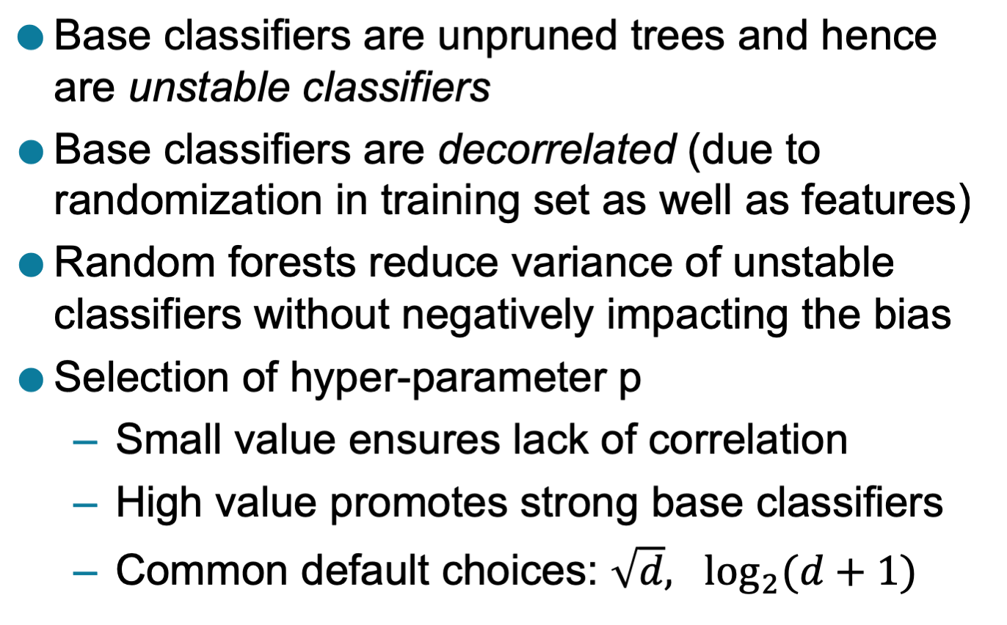
Characteristics of Random Forest

Slide 22
Boosting
An iterative procedure to adaptively change distribution of training data by focusing more on previously misclassified records
Initially, all N records are assigned equal weights (for being selected for training)
Unlike bagging, weights may change at the end of each boosting round

Slide 23
Boosting
Records that are wrongly classified will have their weights increased in the next round
Records that are classified correctly will have their weights decreased in the next round
Example 4 is hard to classify
Its weight is increased, therefore it is more likely to be chosen again in subsequent rounds

Slide 24
Summary
Why Do Ensemble Methods Work?
Necessary Conditions for Ensemble Methods
Bias-Variance Decomposition
General Approach of Ensemble Learning
Bagging (Bootstrap AGGregatING)
Simple Bagging (data points)
Random Forest(data points and attributes)

